Slide 1
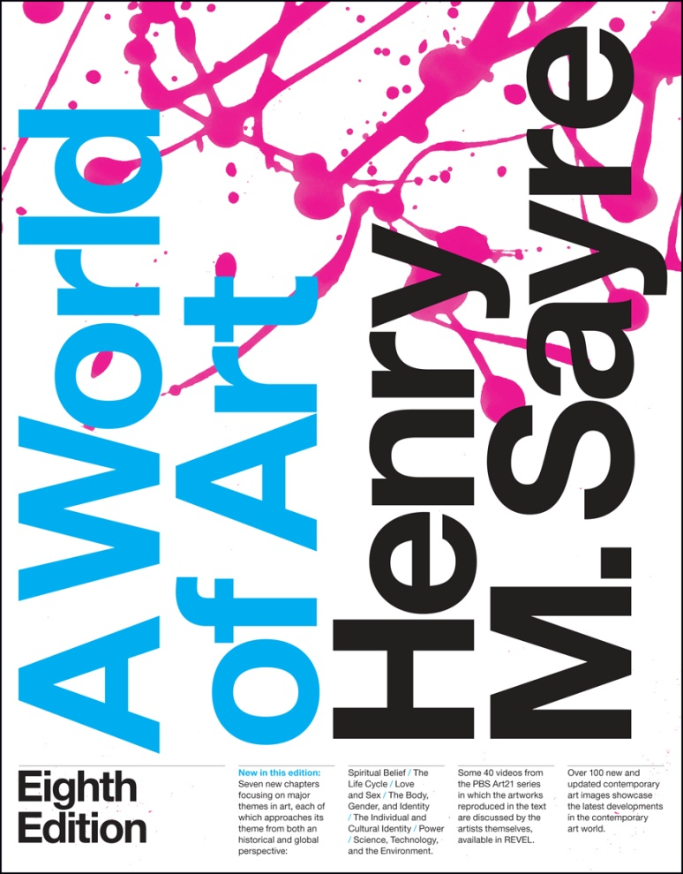
World of Art
Eighth Edition
Chapter 22
The Cycle of Life
Copyright © 2016,2013,2010 Pearson Education, Inc. All Rights Reserved
Notes:
If this PowerPoint presentation contains mathematical equations, you may need to check that your computer has the following installed:
1) MathType Plugin
2) Math Player (free versions available)
3) NVDA Reader (free versions available)

Slide 2
Learning Objectives
22.1 Describe how depictions of pregnancy cause us to reflect on our own humanity.
22.2 Outline some of the narratives suggested by images of youth and aging.
22.3 Discuss some of the ways in which an awareness of our own mortality is reflected in art.
22.4 Outline some of the ways in which burial practices reflect a belief in the afterlife.

Slide 3
Introduction (1 of 3)
In Tibetan Buddhism, the cycle of life is traditionally imaged by a painting of the Bhavacakra, or Wheel of Life.
At the Wheel’s center are three creatures, biting the other’s tail in an endless circle.
  There’s a pig, who represents ignorance, a snake, representing envy and hatred, and a red cock, who stands for lust and greed.

Slide 4
Introduction (2 of 3)
The large areas between the spokes of the wheel depict the six different levels of existence into which one might be reborn.
At the top is a sort of paradise on earth and at the bottom is hell.

Slide 5
Introduction (3 of 3)
The entire Wheel of Life represents the possibility of transforming suffering by understanding how we must transform ourselves if enlightenment can ever be won.
It also represents the constant state of change that is the cycle of life itself.

Slide 6
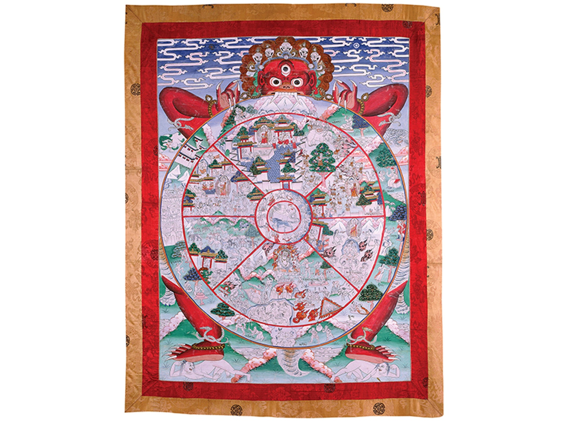
Figure 22-1 Thangka depicting Bhavacakra (Wheel of Life), Bhutan, 15th-17th century
Mineral colors with organic matter. Private collection. Photograph by John C. Huntington. Courtesy of the Huntington Photographic Archive at Ohio State University.

Slide 7
Birth (1 of 4)
The Moche were master potters, depicting almost every aspect of Moche life.
They were the first potters in the Americas to produce clay objects from molds.
Portraits of people, especially rulers, sit atop the vessels and are individualized.

Slide 8
Birth (2 of 4)
The vessel with a birth scene gives a realistic depiction of childbirth, and may symbolize larger notions of fertility and regeneration.

Slide 9
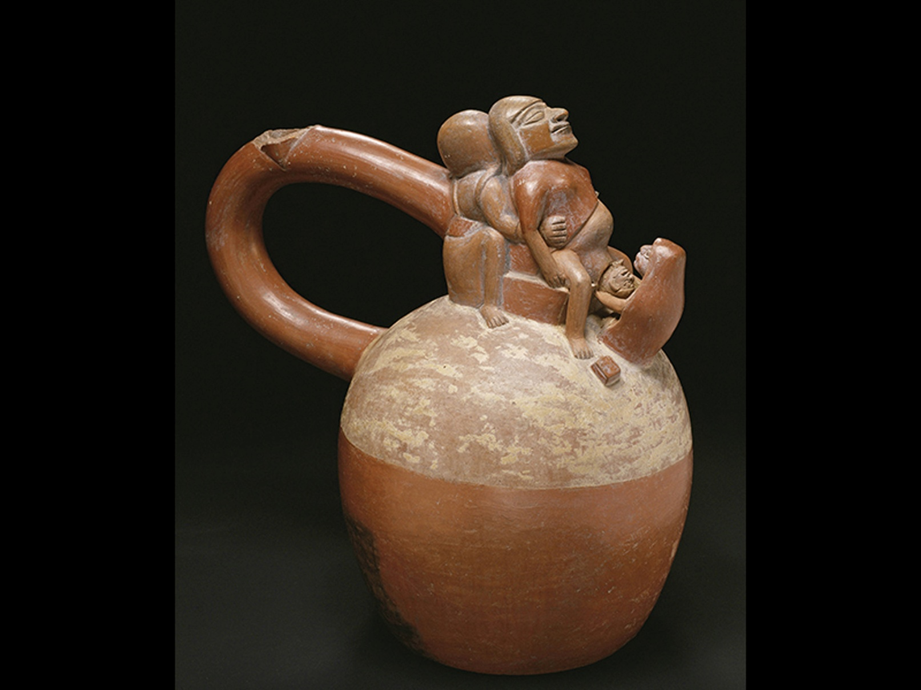
Figure 22-2 Vessel with birth scene, Peru, Moche culture, 0-700 C E
Pottery, height 83/4 in. (spout broken off the handle). Ethnologisches Museum, Staatliche Museen zu Berlin. V A 47912. © 2015. Photo Scala, Florence/bpk, Bildagentur für Kunst, Kultur und Geschichte, Berlin.

Slide 10
Birth (3 of 4)
The connection of birth to the cyclical patterns of nature was clear to Leonardo da Vinci.
The miracle of the fetus in the womb led him to produce the famous anatomical study of an embryo.
Whatever Leonardo was studying he was, at some level, also studying himself.

Slide 11
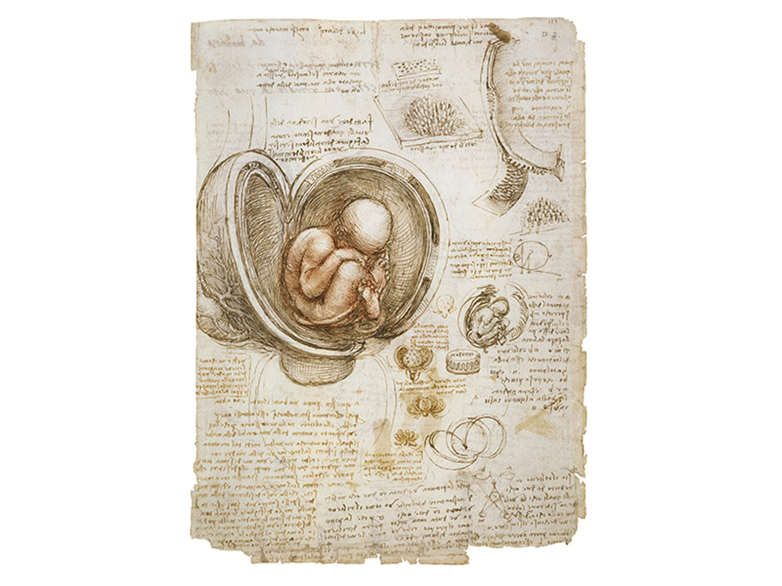

Figure 22-3 Leonardo da Vinci, Embryo in the Womb, c a. 1513
Pen and brown ink,
The Royal Collection. © Her Majesty Queen
Elizabeth II, 2015/Bridgeman Images.

Slide 12
Birth (4 of 4)
We are probably meant to identify with the depictions of Adam and Eve in Jan van Eyck’s Ghent Altarpiece.
Most agree that Eve’s posture suggests her fertility rather than her actual pregnancy.

Slide 13
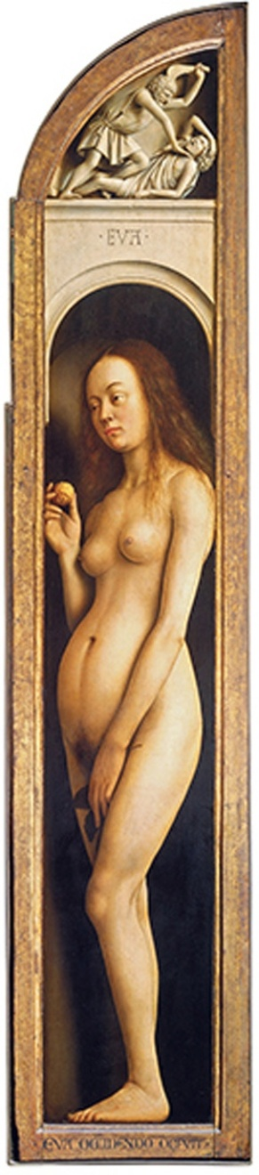

Figure 22-4 Jan van Eyck, Eve panel from The Ghent Altarpiece, c a. 1432
Oil on panel,
Church of St. Bavo, Ghent, Belgium. © 2015. Photo
Scala, Florence.

Slide 14
Young and Age (1 of 7)
John Singer Sargent painted The Daughters of Edward Darley Boit, and in it there is a real sense of disconnection among his subjects.
The painting is a parable of the coming of age of young women in late nineteenth-century society.

Slide 15
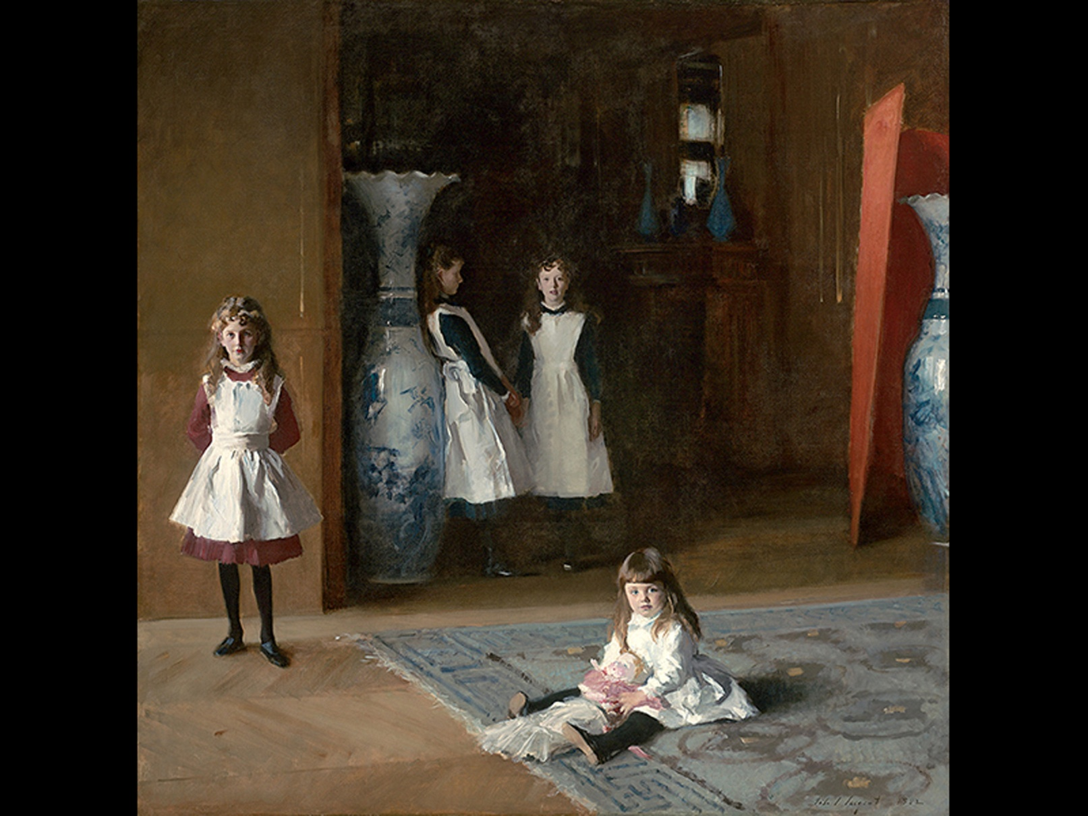
Figure 22-5 John Singer Sargent, The Daughters of Edward Darley Boit, 1882
Oil on canvas,
Museum of Fine Arts, Boston. Gift of
Mary Louisa Boit, Julia Overing Boit, Jane Hubbard Boit, and Florence D. Boit in memory of their father, Edward Darley Boit, 19.124. Photograph © 2015 Museum of Fine Arts, Boston.

Slide 16
Young and Age (2 of 7)
It is within the family that the process of aging-the cycle of life-is most evident to us.
This is the real subject of Nicholas Nixon’s ongoing series of photographs depicting his wife and her three sisters.

Slide 17
Young and Age (3 of 7)
Every year since 1975, Nixon has made a black-and-white photograph of the four, always showing them arranged in the same order from left to right.
The series is not only a testament to time’s relentless force, but to the power of family and love-in spite of time itself.

Slide 18
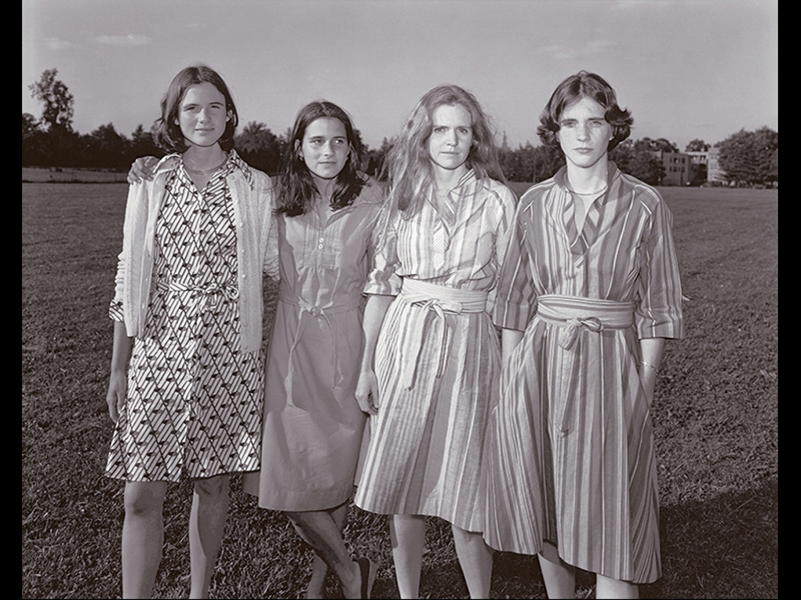

Figure 22-6 Nicholas Nixon, The Brown Sisters, 1976
Gelatin silver print,
Museum of Modern Art, New York.
Francisco. ©Nicholas Nixon, courtesy of Fraenkel Gallery, San Francisco.

Slide 19
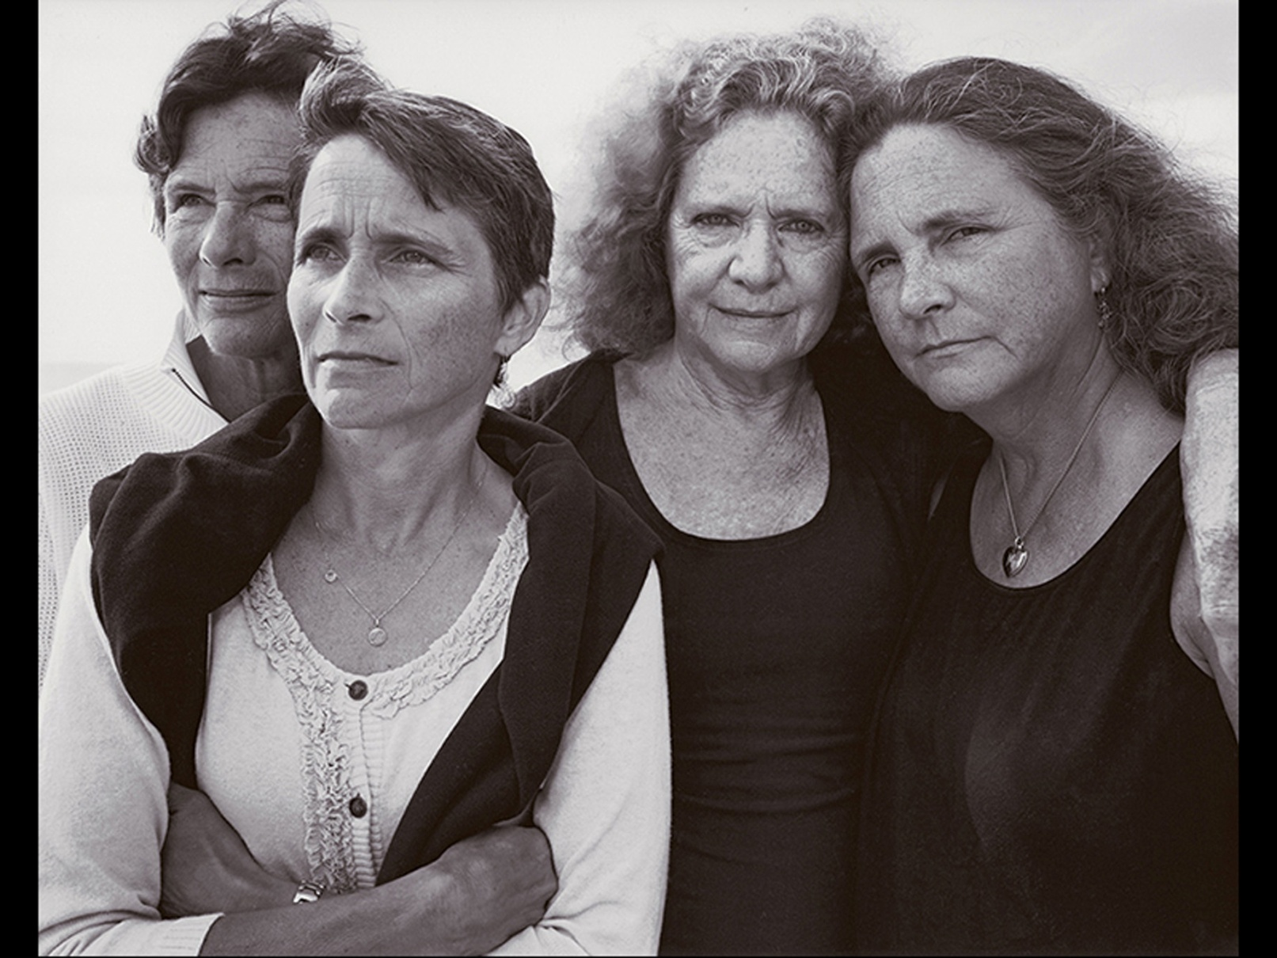
Figure 22-7 Nicholas Nixon, The Brown Sisters, Truro, Massachusetts, 2011
Gelatin silver print,
Museum of Modern Art, New York. ©
Nicholas Nixon, courtesy of Fraenkel Gallery, San Francisco.

Slide 20
Young and Age (4 of 7)
The feminist, activist, and artist Suzanne Lacy has continually addressed the issue of aging in American society since 1976.
One of the most visually spectacular of Lacy’s works on this theme is Whisper, the Waves, the Wind.

Slide 21
Young and Age (5 of 7)
In this performance, 154 women over the age of 65 sat around white cloth-covered tables and talk about their lives.

Slide 22
Young and Age (6 of 7)
The piece was motivated by several facts:
  By 2020, one in five people in the U.S. will be over 65.
  This population will be predominantly female and single.
  Today, women account for nearly 75 percent of the aged poor.

Slide 23
Young and Age (7 of 7)
The performance reinforced the strong spiritual and physical beauty of older women.
The image of these women, in white, in this setting, also helps us to understand the beauty of their aging.

Slide 24
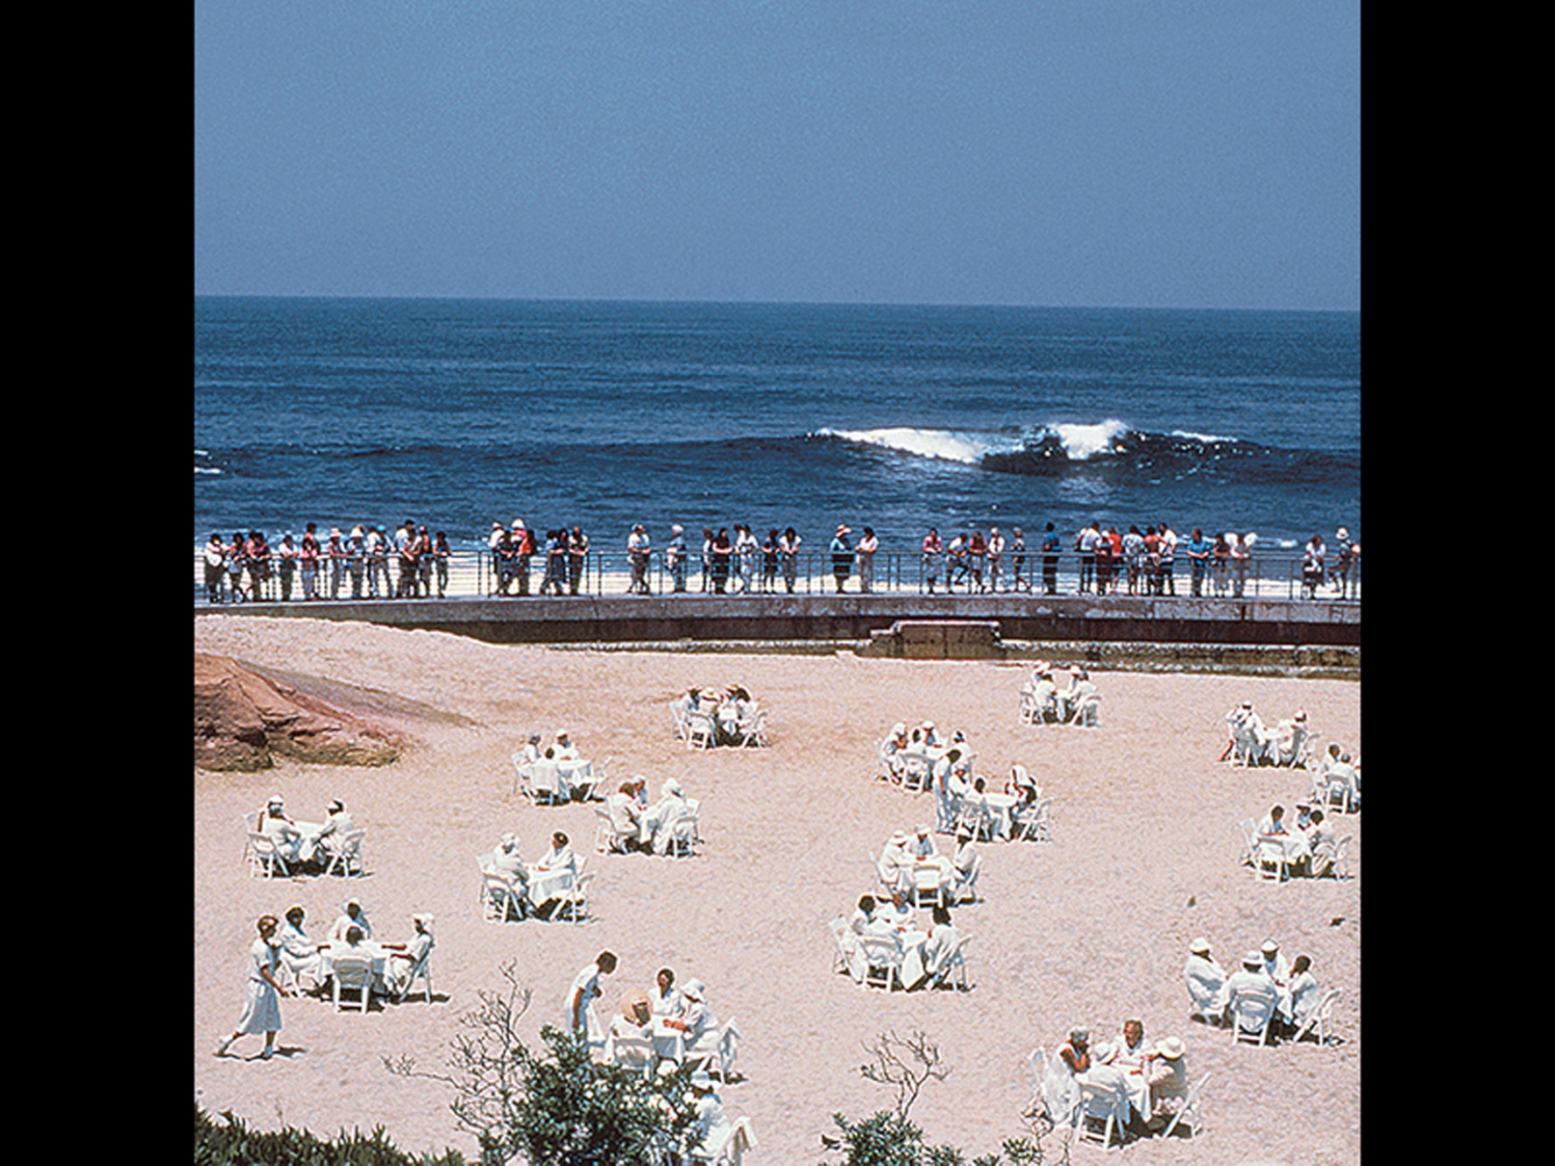
Figure 22-8 Suzanne Lacy, Whisper, the Waves, the Wind, 1984
Site photograph of a performance in the Whisper Projects. Courtesy of Suzanne Lacy.

Slide 25
Contemplating Mortality (1 of 8)
The inevitable fact of death has troubled and fascinated the human imagination.
Çatalhöyük was a village that flourished around 7400 BCE.
It was concluded that its culture was matrilineal based on multiple female figurines found.

Slide 26
Contemplating Mortality (2 of 8)
One figurine of a seated woman was believed to represent a fertility goddess.
Now, she is interpreted as a woman turning into an ancestor, as a woman associated with death, or as death and life conjoined.
It is as if, in Çatalhöyük, it was well understood that death lurks behind life.

Slide 27
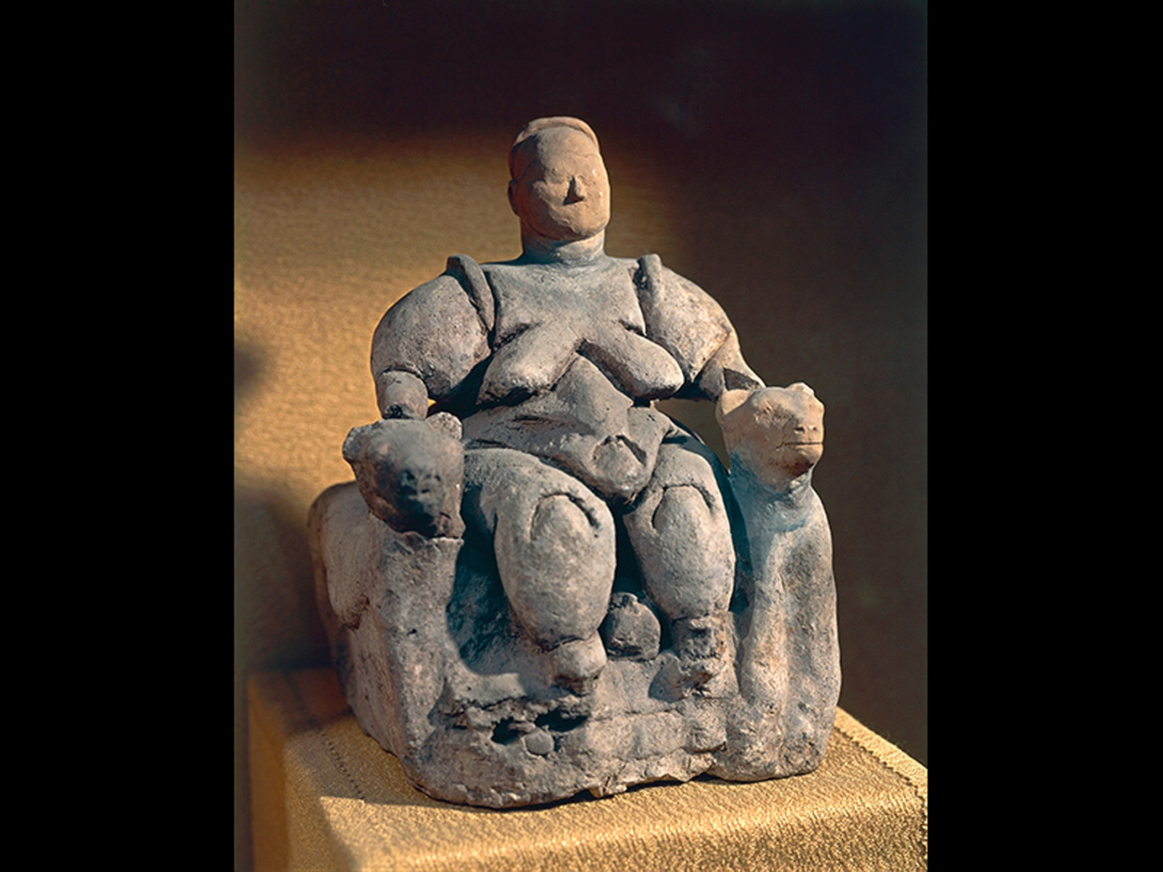

Figure 22-9 Woman seated between two felines, Çatalhöyük, Turkey
c a. 6850-6300 B C E. Terra cotta, height
Museum of Anatolian
Civilizations, Ankara. akg-image/De Agostini Picture Lib./M. Seemuller.

Slide 28
Contemplating Mortality (3 of 8)
This was the motivation for depictions of the decaying body in the Japanese art of kusozu.
The text the Discourse on the Great Wisdom argues that contemplation of the nine stages of a decaying corpse allows one to overcome love of the body and carnal desire, and come ever close to enlightenment.

Slide 29
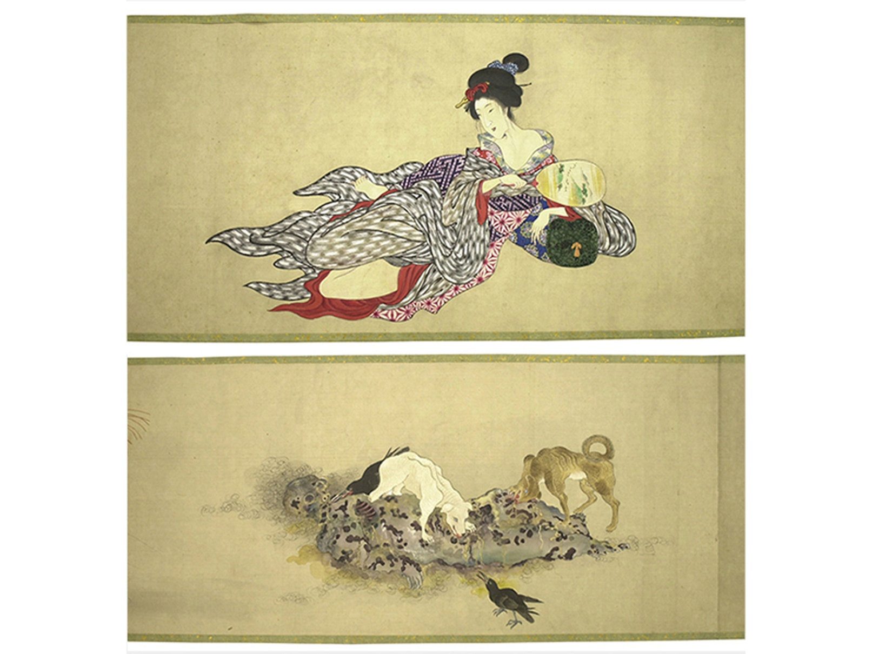

Figure 22-10 Kobayashi Eitaku
Two scenes from the handscroll Body of a Courtesan in Nine Stages of
Decomposition. 1870s. Ink and color on silk,
The British
Museum, London. 2008,3033.1. © The Trustees of the British Museum.

Slide 30
Contemplating Mortality (4 of 8)
Fascination with death and the thinking of our own mortality was never more all-consuming than it was in the fourteenth century because of the bubonic plague.

Slide 31
Contemplating Mortality (5 of 8)
The Book of Hours is a good example.
  The images of The Three Living and The Three Dead in the Psalter and Hours of Bonne of Luxembourg are an example of what is known as a memento mori.
    Memento mori translates as “remember that you will die.”

Slide 32
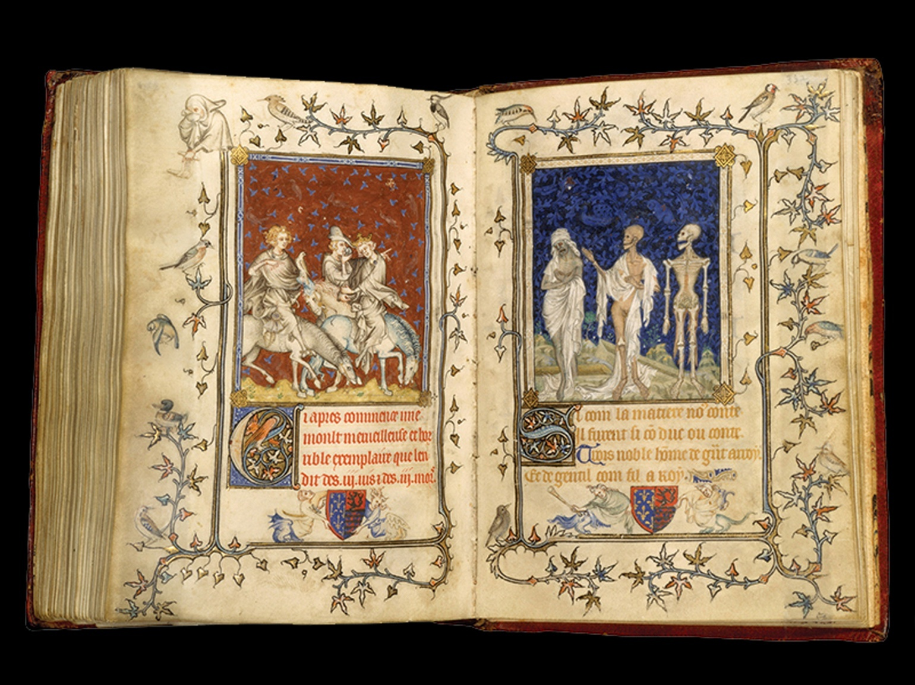

Figure 22-11 Jean Le Noir
Pages with The Three Living (left) and The Three Dead (right), from the Psalter and Hours of Bonne of Luxembourg, Duchess of Normandy. Before 1349. Grisaille, color,
gilt, and brown ink on vellum
in. opened. Metropolitan
Museum of Art, New York. Cloisters Collection, 1969.86 © 2015. Image copyright Metropolitan Museum of Art/Art Resource/Scala, Florence.

Slide 33
Contemplating Mortality (6 of 8)
Nicolas Poussin’s The Shepherds of Arcadia is another example of memento mori and a directive to lead a virtuous, even ascetic life.
Vanitas paintings such as Still Life with Lobster by Jan de Heem are also examples of the memento mori tradition because their models were dead specimens.

Slide 34
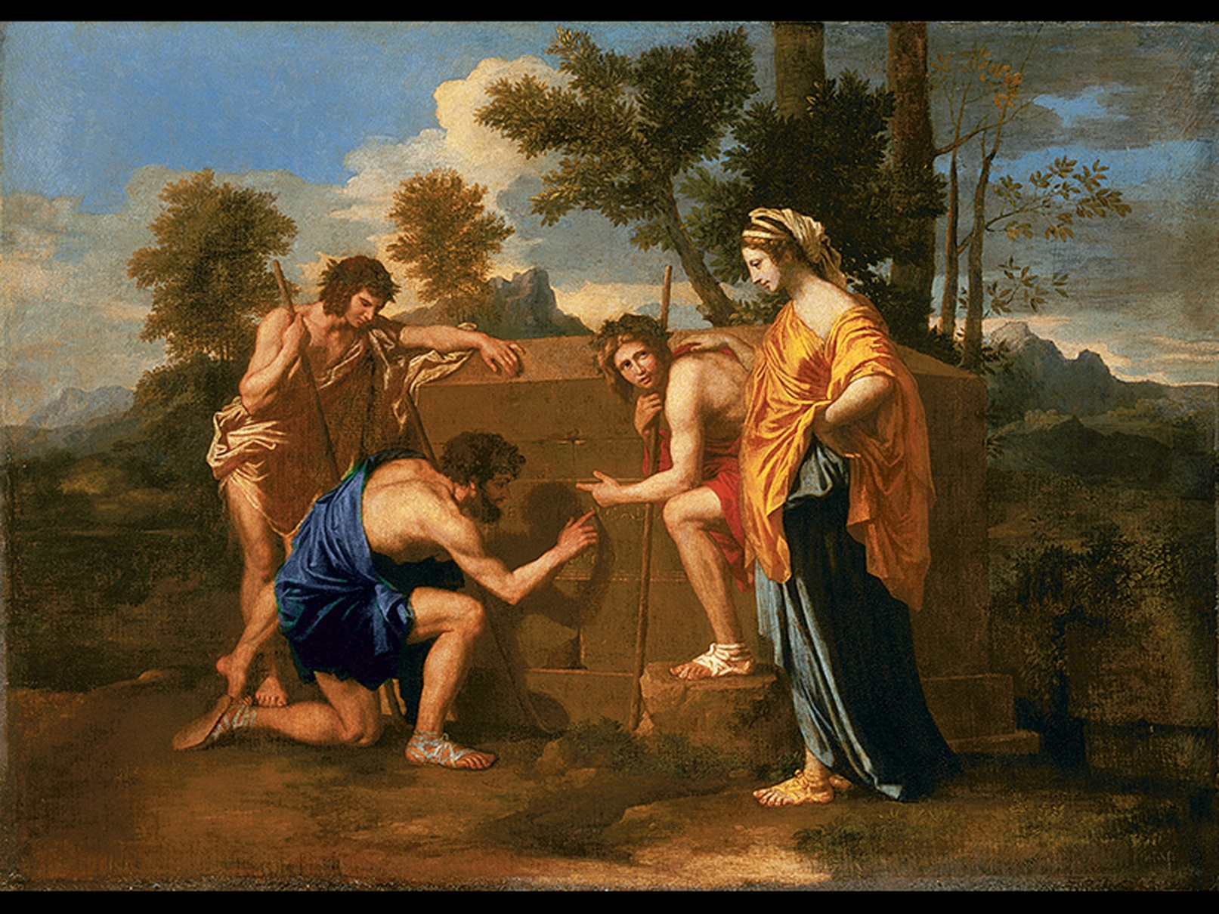

Figure 22-12 Nicolas Poussin, The Shepherds of Arcadia (a.k.a. Et in Arcadia Ego), 1638-39
Oil on canvas,
Musée du Louvre, Paris. Inv. I N V7300. Photo ©
Musée du Louvre, Dist. R M N-Grand Palais/Angèle Dequier.

Slide 35
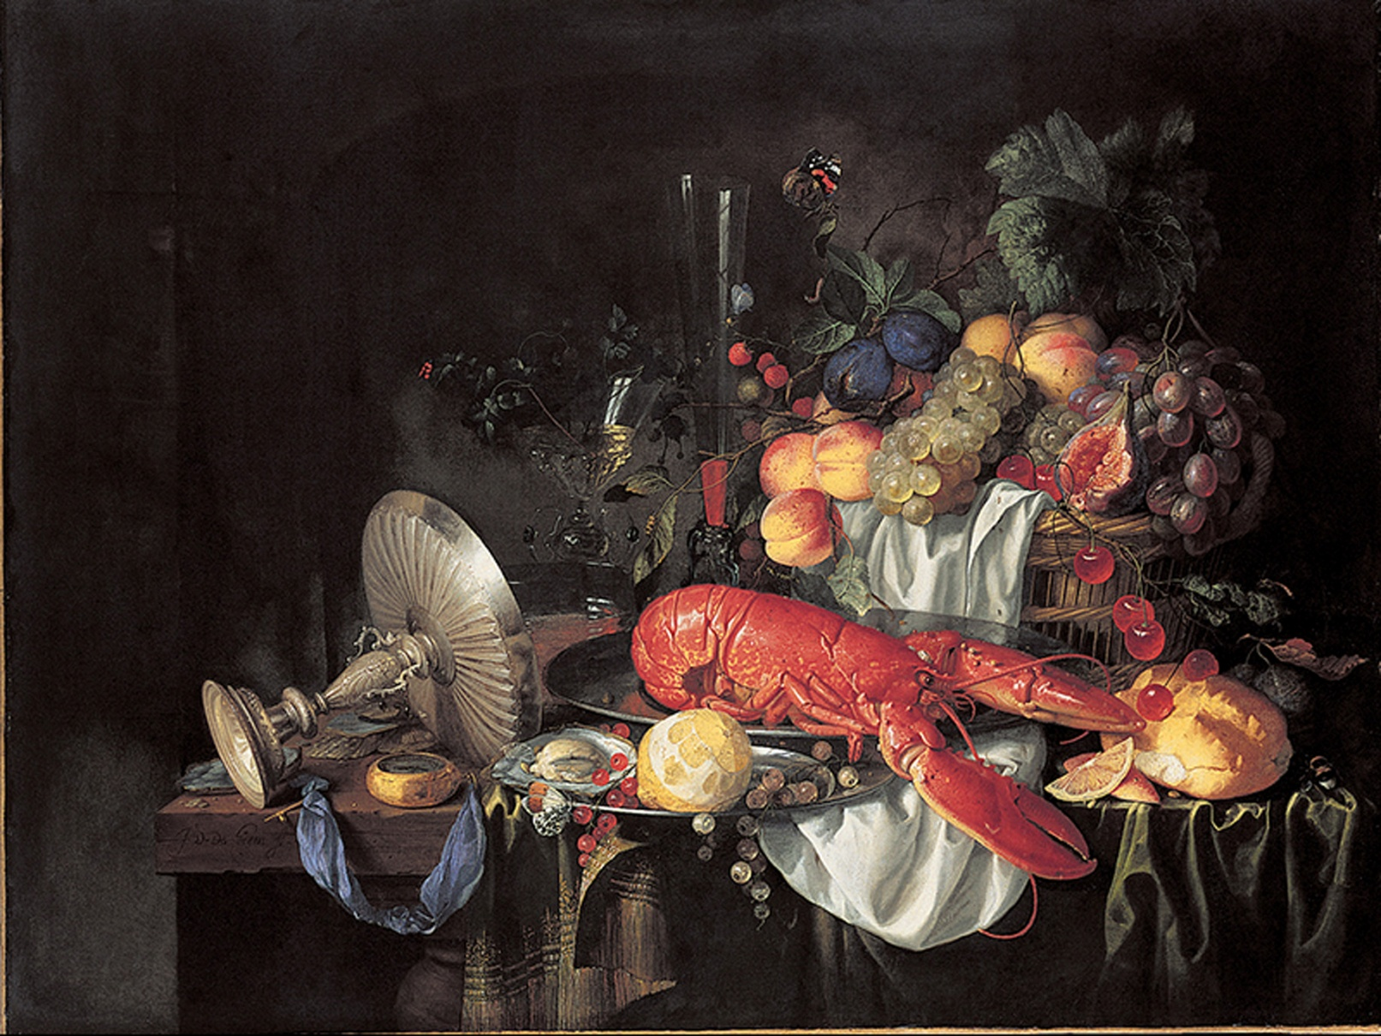

Figure 22-13 Jan de Heem, Still Life with Lobster, late 1640s
Oil on canvas,
Toledo Museum of Art, Toledo, Ohio. Purchased
with funds from the Libbey Endowment. Gift of Edward Drummond Libbey, 1952.25. Photo: Photography Incorporated, Toledo.

Slide 36
Contemplating Mortality (7 of 8)
Still-life arrangements of flowers were among Robert Mapplethorpe’s favorite subjects.
  Calla Lily was shot in 1986, the same year that Mapplethorpe was diagnosed with AIDS and during the height of the AIDS contagion.
  It is also considered momento mori.

Slide 37
Contemplating Mortality (8 of 8)
Still-life arrangements of flowers were among Robert Mapplethorpe’s favorite subjects.
  He invokes the battle for life in the midst of the dark of death-a spiritual strength in the face of AIDS.

Slide 38
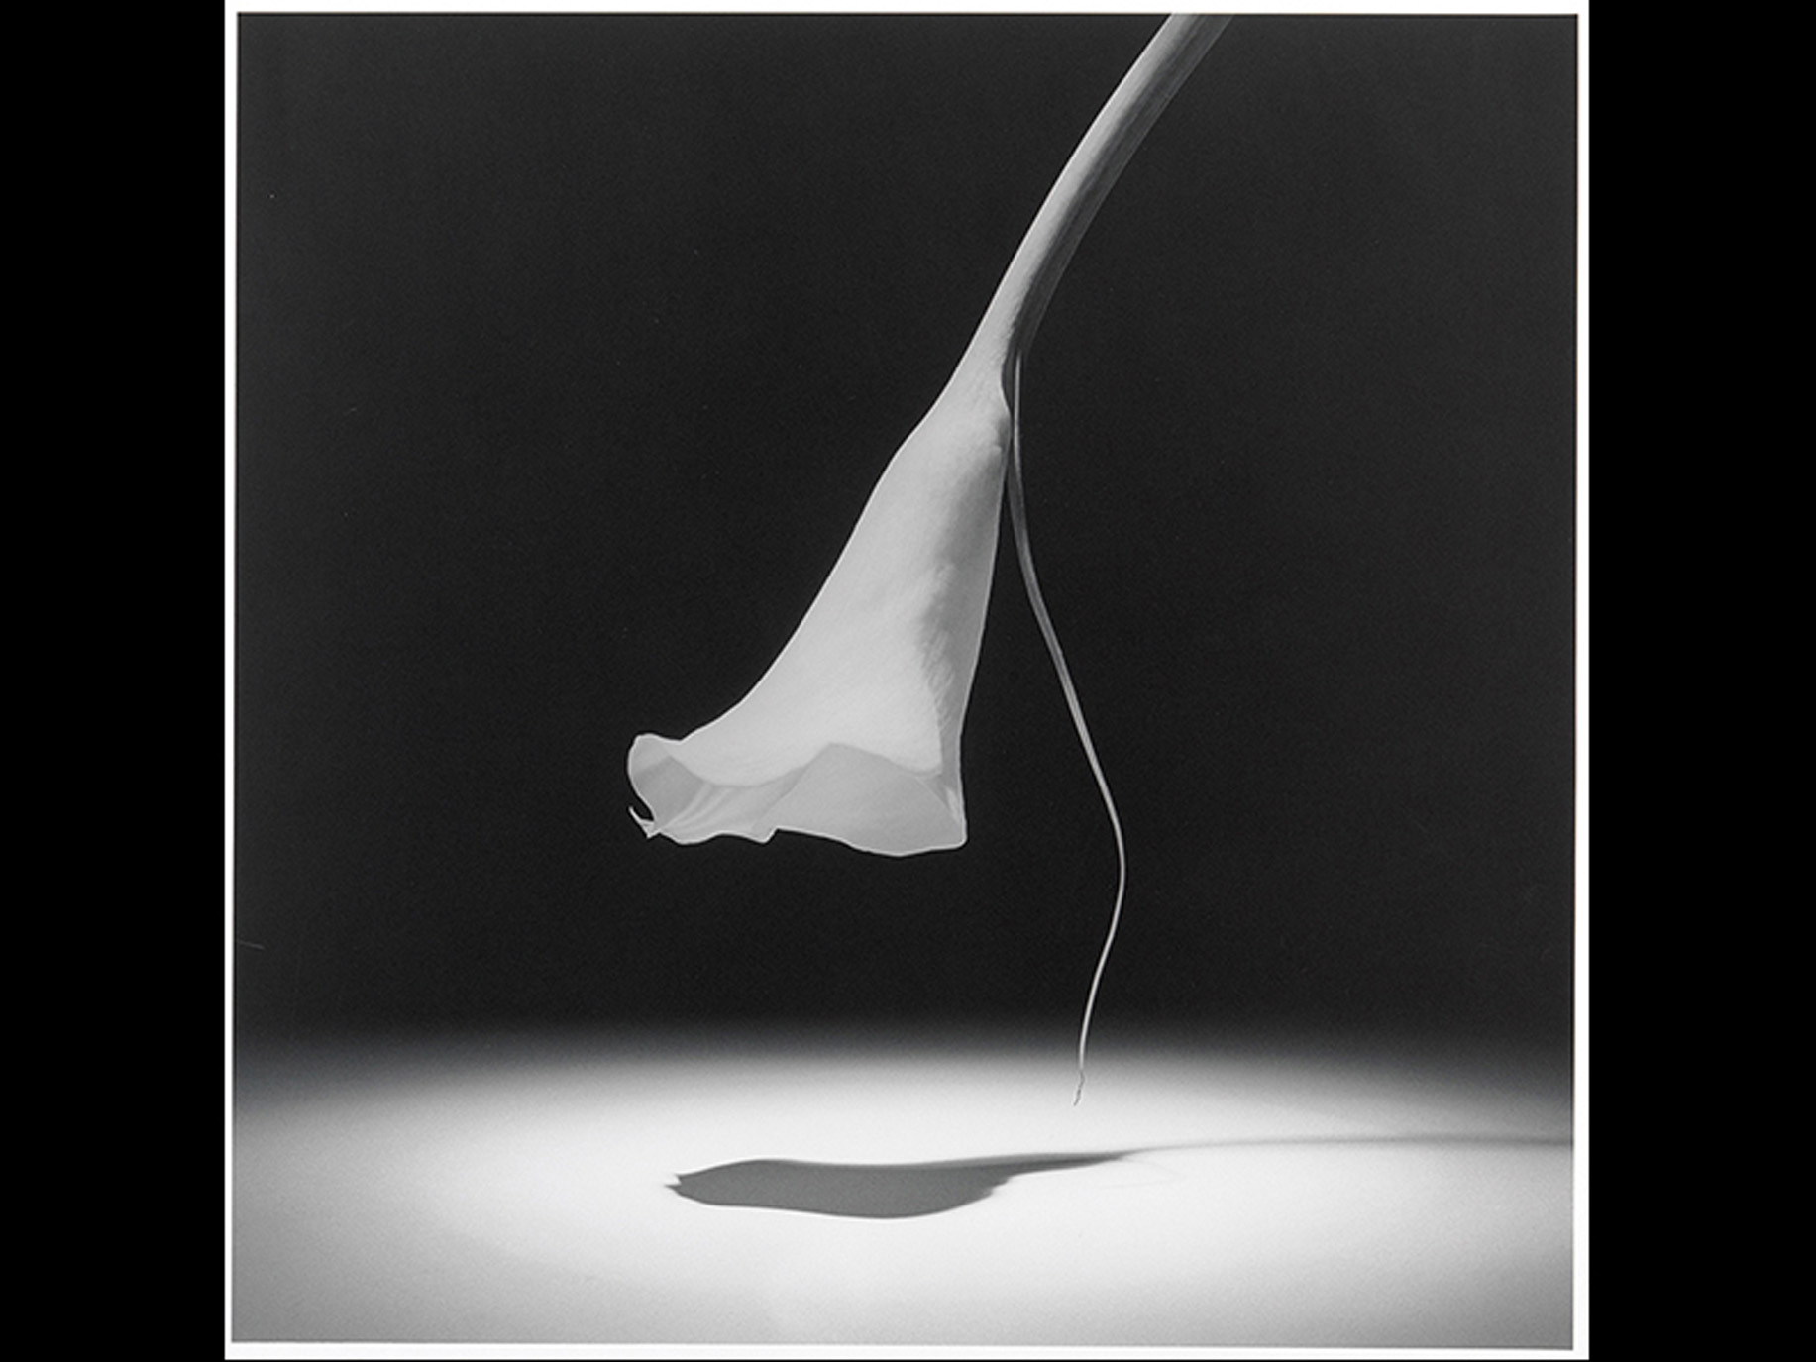

Figure 22-14 Robert Mapplethorpe, Calla Lily, 1986
Gelatin silver print,
Solomon R. Guggenheim Museum, New
York. Gift, 93.4302. © Robert Mapplethorpe Foundation. Used by permission of Art + Commerce.

Slide 39
Burial and the Afterlife (1 of 7)
Art and architecture have traditionally been associated with burial sites and the possibility of an afterlife in some other realm.
The great pyramids at Giza are expressions of a sense of cyclical return.

Slide 40
Burial and the Afterlife (2 of 7)
The pyramids were the largest of the resting places designed to house the ka.
  One theory states that the pyramids’ sides represented the descending rays of the sun god Re.
  Another is that the three pyramids are aligned to reflect the three stars that form the belt of the constellation Orion.

Slide 41
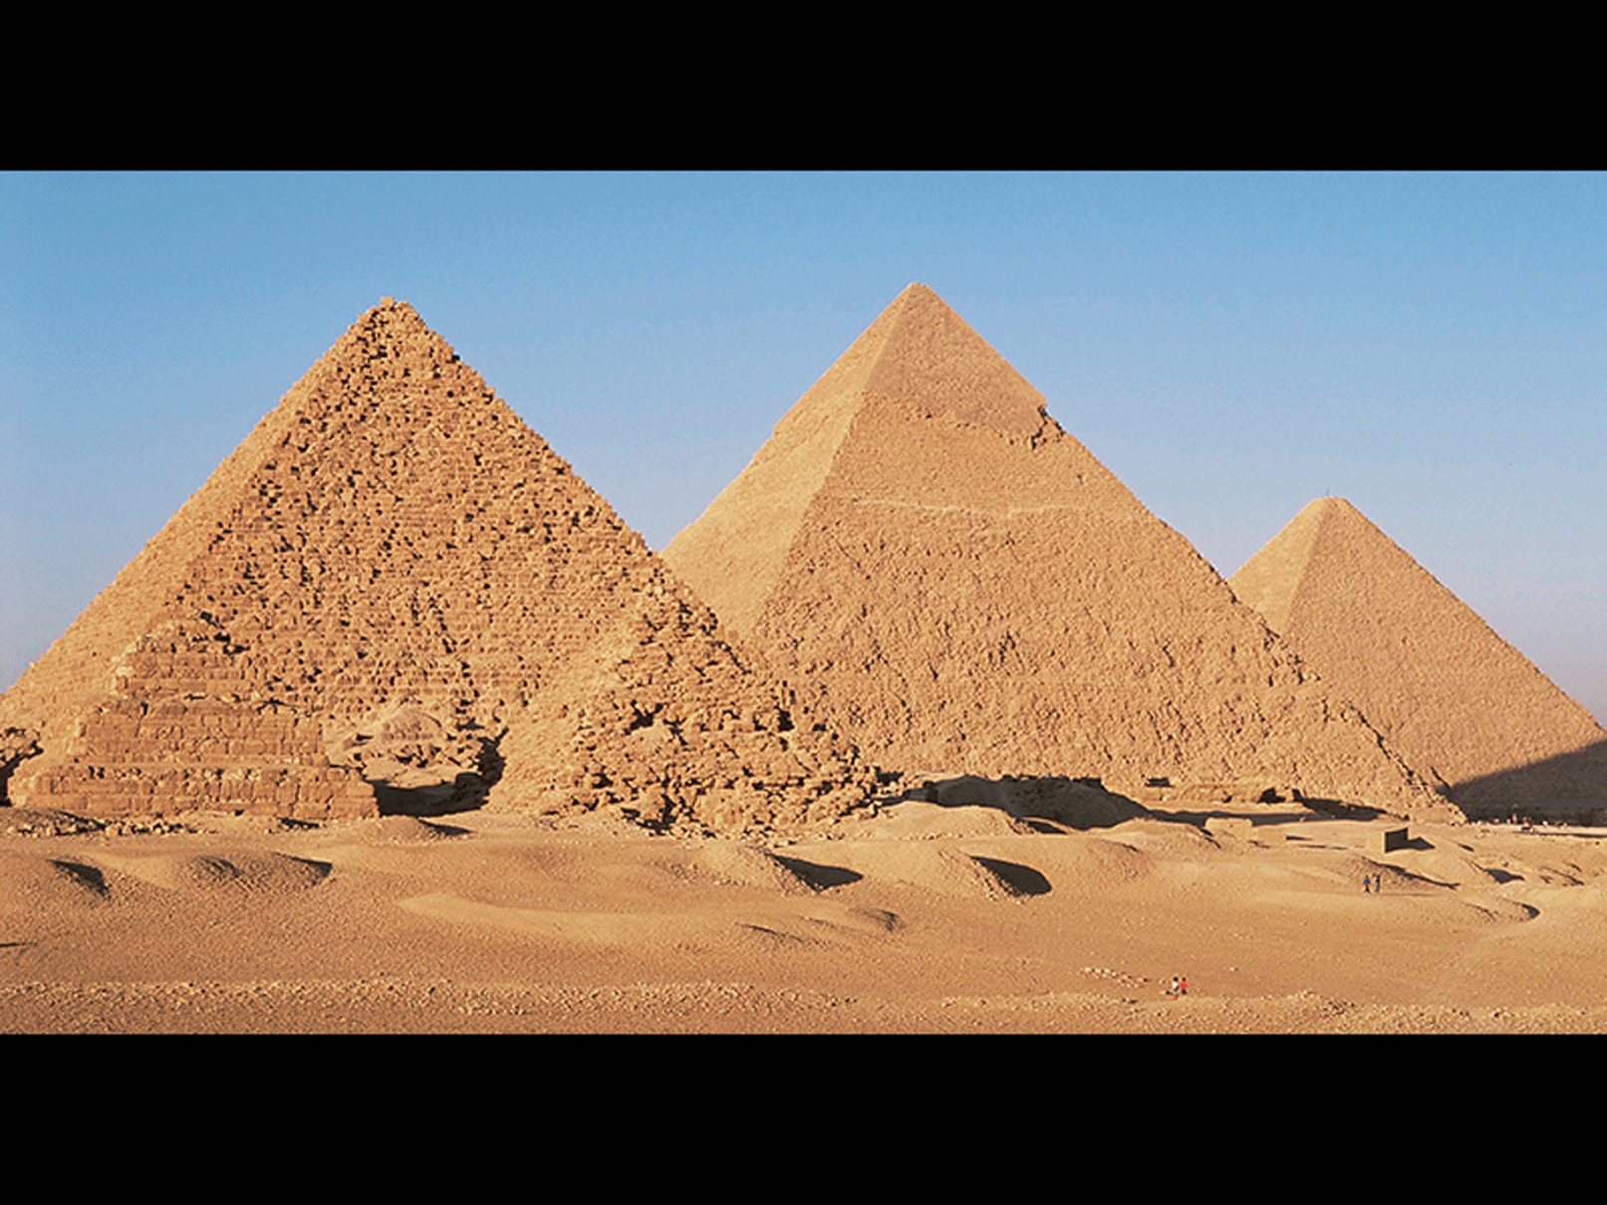

Figure 22-15 Pyramids of Menkaure
Pyramids of Menkaure, Khafre, and KhufuPyramids of Menkaure (c a. 2470 B C E), Khafre (c a. 2500 B C E), and Khufu (c a. 2530 B C E). Original height of Pyramid of Khufu 480’,
length of each side at base
© Free Agents Limited/CORBIS. Photo: Dallas and
John Heaton.

Slide 42
Burial and the Afterlife (3 of 7)
Burial prepared a king for a “last judgment,” which was routinely illustrated in Books of Going Forth by Day.
Like the Egyptian pyramids, the Temple of Inscriptions at Palenque was erected over the king’s grave and rises in nine steps, representing nine levels of the Mayan Underworld.

Slide 43
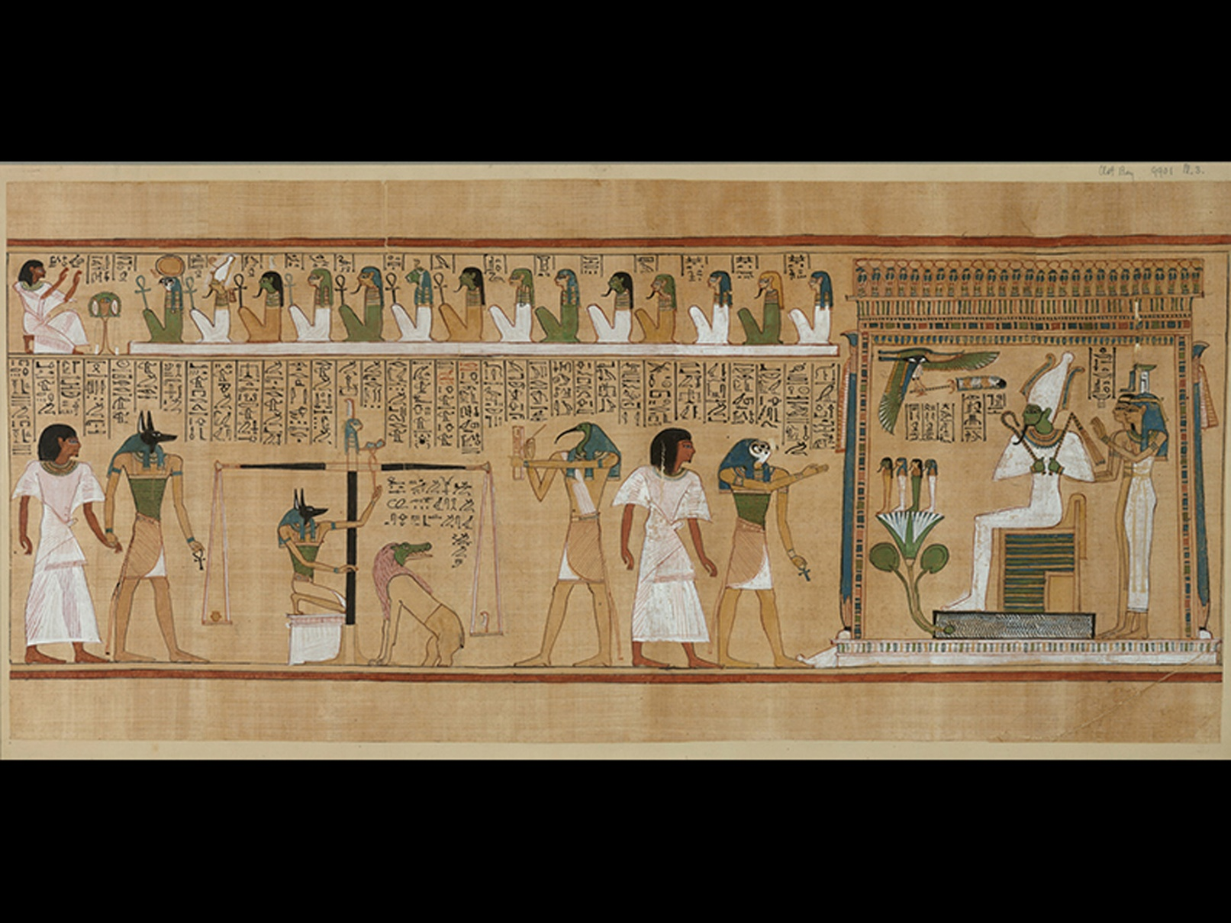

Figure 22-16 Last Judgment of Hunefer by Osiris
From a Book of Going Forth by Day in his tomb at Thebes. Dynasty 19, c a. 1285 B C E.
Painted papyrus scroll, height
The British Museum, London. © The Trustees
of the British Museum.

Slide 44
Burial and the Afterlife (4 of 7)
The lid of the king’s sarcophagus represents Pacal falling off the Wacah Chan, the great tree that connects the Upperworld, the Middleworld, and the Underworld.
Cultures often treat the death of their rulers with special memorial architecture.

Slide 45
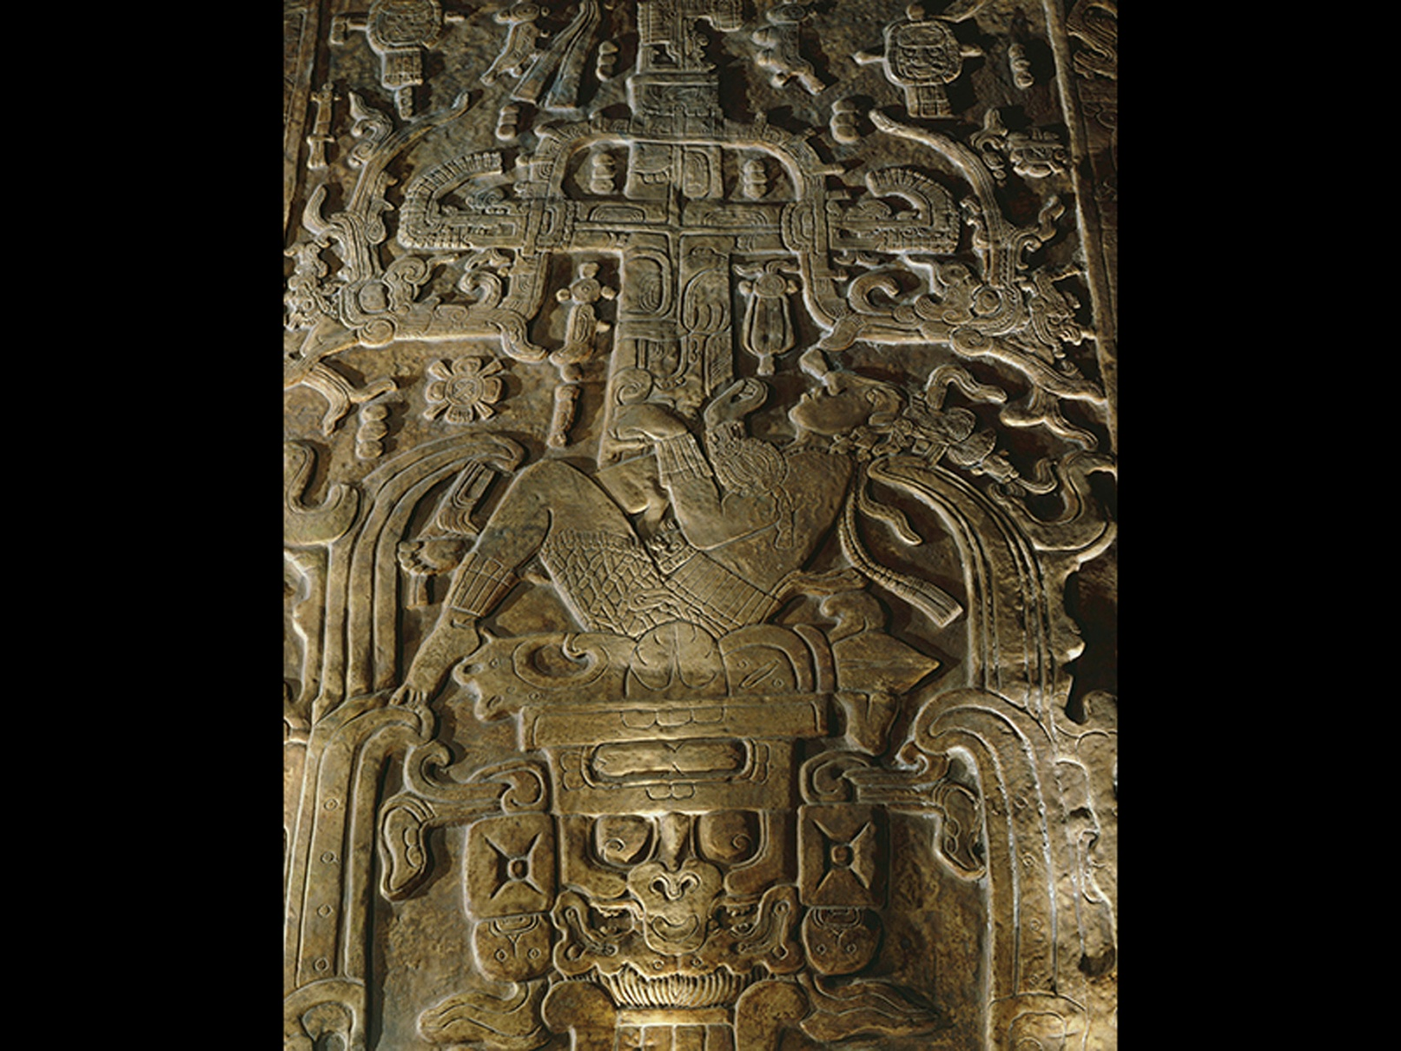

Figure 22-17 Cast of sarcophagus cover of K’Inich Janab Pacal
Died 683 C E, from the Temple of Inscriptions, Palenque, Mexico. Limestone,
National Anthropological Museum, Mexico. Art Archive/National Anthropological Museum Mexico/Gianni Dagli Orti.

Slide 46
Burial and the Afterlife (5 of 7)
Before the nineteenth century, most burial sites in Europe and America were in the middle of the towns.
In Frank, they realized these were a breeding ground for disease and reburied the dead in catacombs beneath the cities.

Slide 47
Burial and the Afterlife (6 of 7)
This vast removal of the dead amounted to a banishment of the specter of death from the daily life of the city.
Napoleon decreed each corpse would have an individual plot in one of four garden environments outside the city proper-one being the Père Lachaise Cemetery.

Slide 48
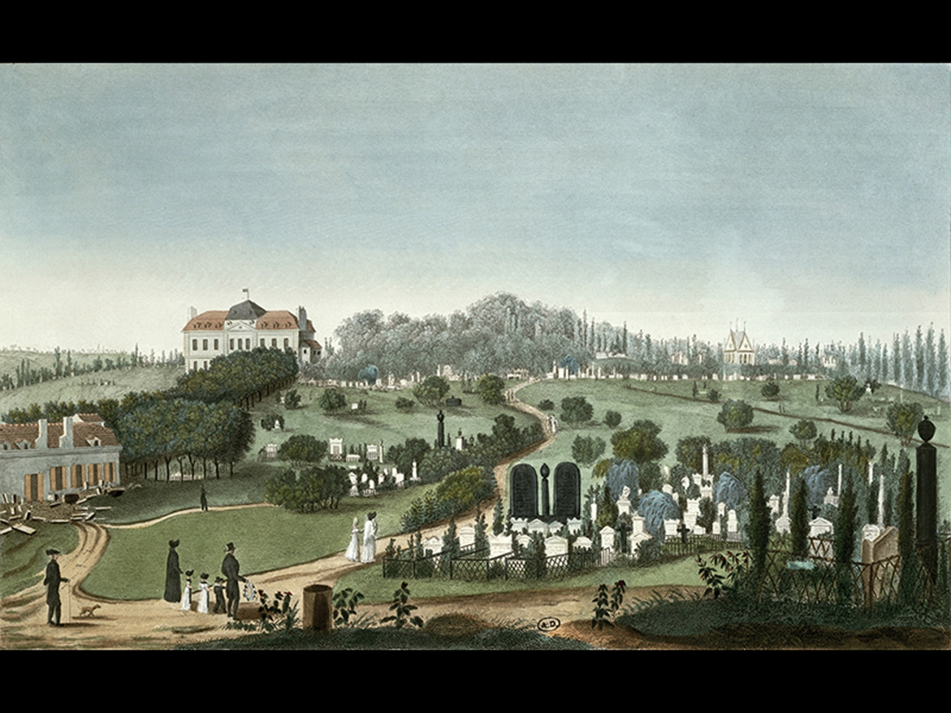
Figure 22-18 After Pierre Courvoisier, View of Père Lachaise Cemetery from the Entrance, 1815
Color engraving. Bibliothèque des Arts Décoratifs, Paris. Archives Charmet/Bridgeman Images.

Slide 49
Burial and the Afterlife (7 of 7)
In Mexican culture, the dead are remembered with ofrendas, temporary altars generally created for the annual Dia de los Muertos celebration.
In 1984, the year after actress Dolores del Rio died, Amalia Mesa-Bains created An Ofrenda for Dolores del Rio.
  It honors someone who inspired and affirmed her own artistic life.

Slide 50
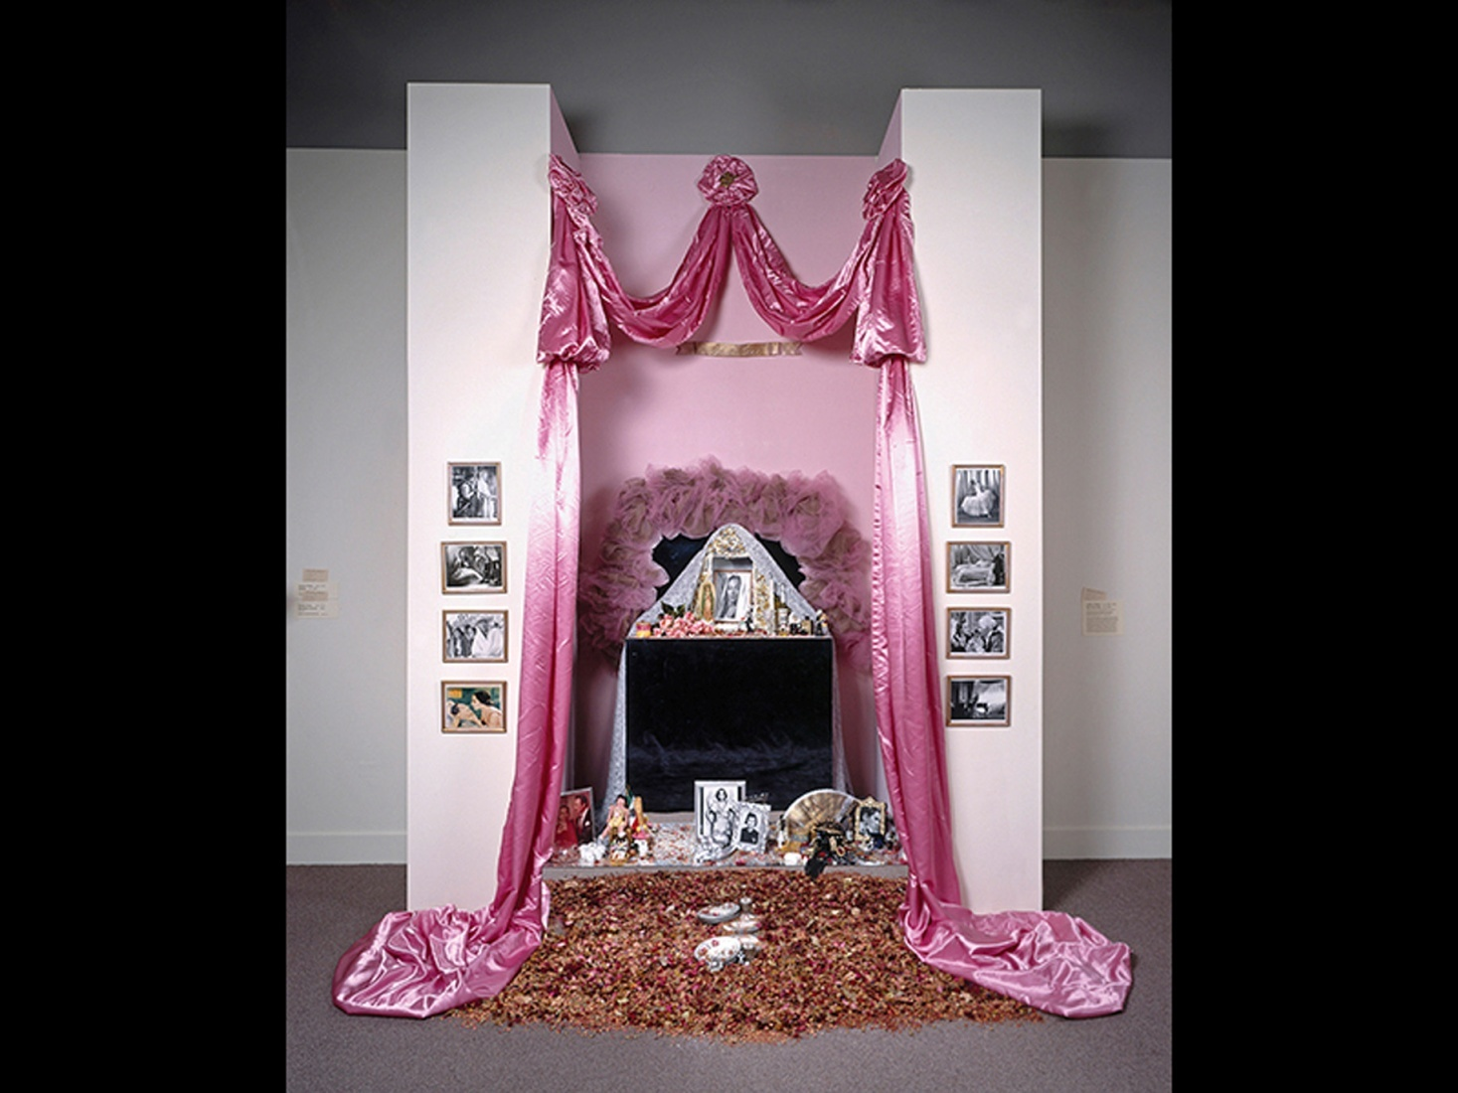

Figure 22-19 Amalia Mesa-Bains, An Ofrenda for Dolores del Rio, 1984, revised 1991
Mixed-media installation including plywood, mirrors, fabric, framed photographs, found
objects, dried flowers, and glitter, dimensions variable; as seen here, approx.
Smithsonian American Art Museum, Washington, D.C. Museum purchase through the Smithsonian Institution Collections Acquisition Program, 1998.161. © 2015. Photo Smithsonian American Art Museum/Art Resource/Scala, Florence. © 2015 Amalia Mesa-Bains.

Slide 51
The Critical Process: Thinking about the Cycle of Life (1 of 2)
In 2013, choreographer Stephen Petronio asked artist Janine Antoni if she would be interested in doing the visuals for his new dance, Like Lazarus Did.
The work was inspired by themes of birth, death, and resurrection.

Slide 52
The Critical Process: Thinking about the Cycle of Life (2 of 2)
For the hour-long performance, Antoni lay completely still, a caged light bulb in her left hand, suspended above the audience, contemplating her own body and her own death.
Petronio and Antoni collaborated on a 14-minute video of a dancer moving in a honey-coated tube, which they called Honey Baby-imitating the womb.

Slide 53
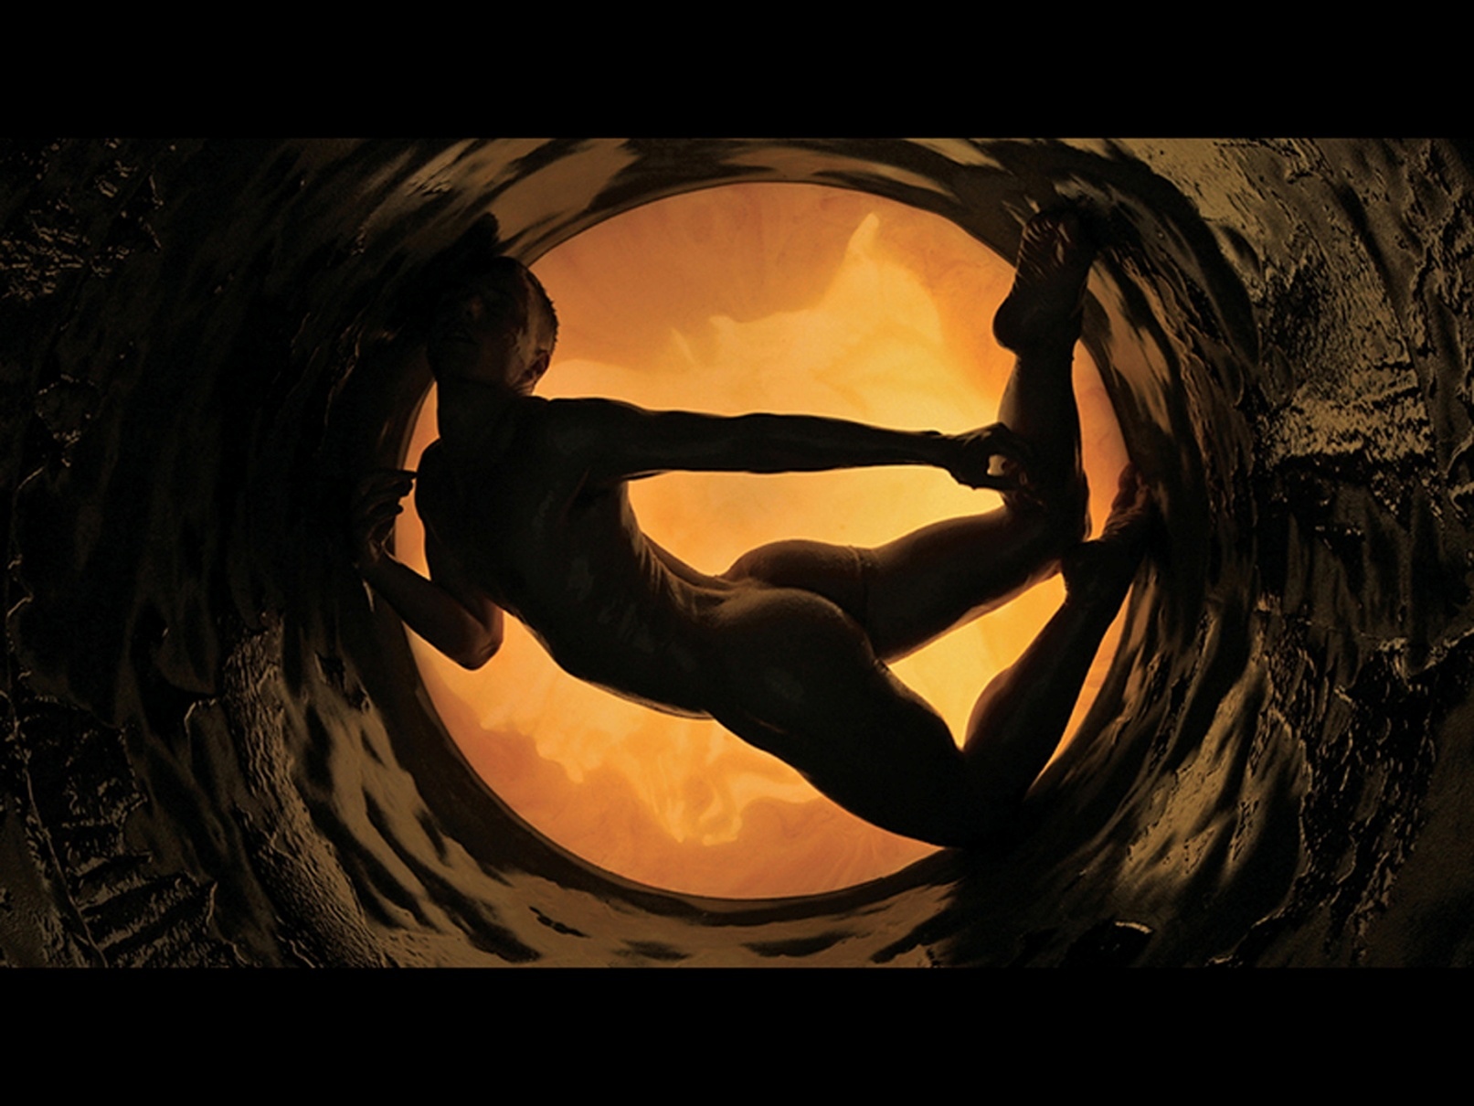
Figure 22-20 Janine Antoni and Stephen Petronio, Honey Baby, 2013
Honey Baby Performer: Nick Sciscione. Videographer: Kirsten Johnson. Composer: Tom Laurie. Editor: Amanda Laws. 2013. Still. Video, 14 min. Edition of 10 and 4 A P. Courtesy of the artists and Luhring Augustine, New York

Slide 54
Thinking Back (1 of 2)
Describe how depictions of pregnancy cause us to reflect on our own humanity.
Outline some of the narratives suggested by images of youth and aging.
Discuss some of the ways in which an awareness of our own mortality is reflected in art.

Slide 55
Thinking Back (2 of 2)
Outline some of the ways in which burial practices reflect a belief in the afterlife.

Slide 56

Copyright

